Slide 1
Data Management Services at SURF

Slide 2
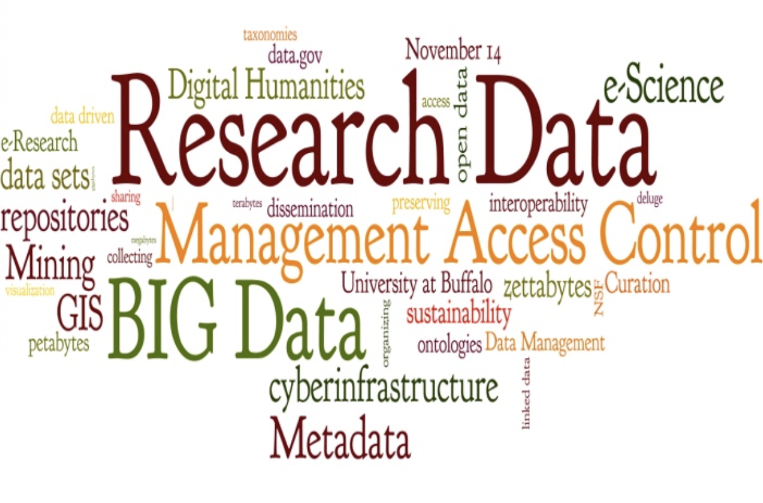
Research Data Management
Research Data: “materials generated or collected during the course of conducting research”, by The National Endowment for the Humanities.
Data Management: Actions that contribute to effective storage, preservation and reuse of data and documentation throughout the research lifecycle.

Slide 3
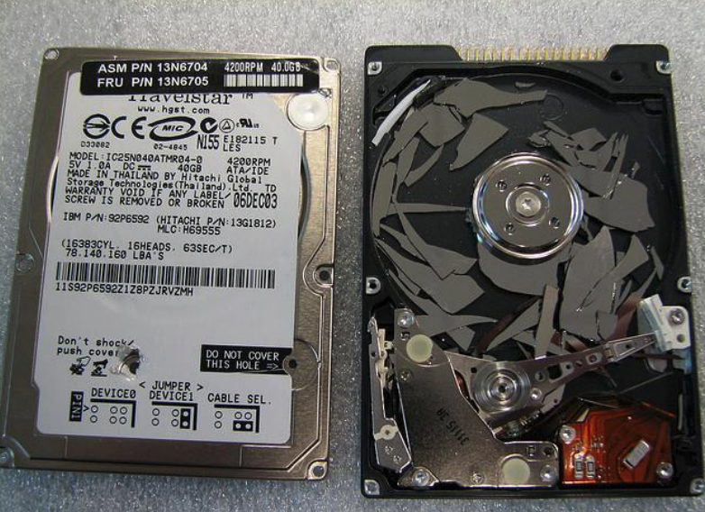
Data Challenges
Data Explosion
More and more data is being created
Navigate, transfer and share data
Reuse existing data
Data Loss:
Natural disaster, infrastructure failure, storage failure, …
Application software failure, Format obsolescence,…
Human error, malicious attack,..
Notes:
Digital data are fragile and susceptible to loss

Slide 4
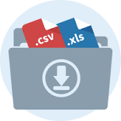

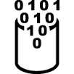



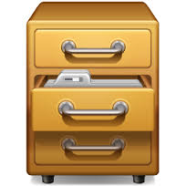

A Typical Problem in handling Research Data
?

Slide 5
Researcher’s needs
Store data during research
Share data during and after research
Synchronize data across different locations
Backup data
Archive data
Publish data
Link publication to processed and raw data
Find data and make data findable by others
Data transfer
Data provenance: what happened with the data
…

Slide 6
Research Data Lifecycle
CREATING DATA: designing, planning consent, collection and management, capturing and creating metadata
Creating data
PROCESSING DATA: entering, transcribing, checking & validating, anonymizing and describing
Re-using data
Processing data
RE-USING DATA: for follow-ups, new research, research reviews, scrutinising, teaching & learning
TRUST
ACCESS TO DATA: distributing, sharing, controlling access, promoting
Giving access to data
Analysing data
ANALYSING DATA: interpreting, deriving, producing outputs & publishing, preparing for sharing
Preserving data
PRESERVING DATA: migrating, backing-up, storing, creating metadata and documentation, archiving
Ref: UK Data Archive: http://www.data-archive.ac.uk/create-manage/life-cycle

Slide 7
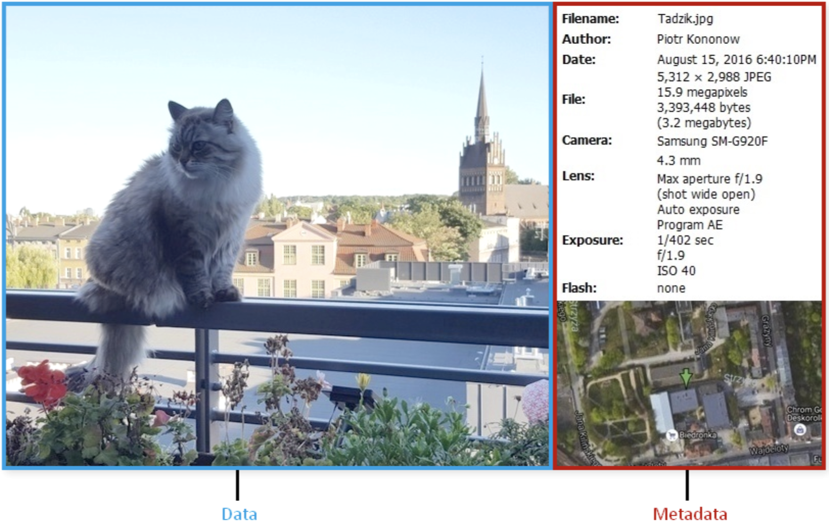




Metadata, data about data
Types of metadata:
- Descriptive: information about the content and context of the data
- Structural: information about the structure of the data
- Administrative: information about the file type, rights management and preservation processes
What is metadata?
Metadata is ‘data about data’, which helps to make data findable and understandable
Why using metadata?
Facilitate data discovery
Help users determine the applicability of the data
Enable interpretation and reuse of data
Allow any limitations to be understood
Clarify ownership and restrictions on reuse
Ref: https://dataedo.com/kb/data-glossary/what-is-metadata

Slide 8
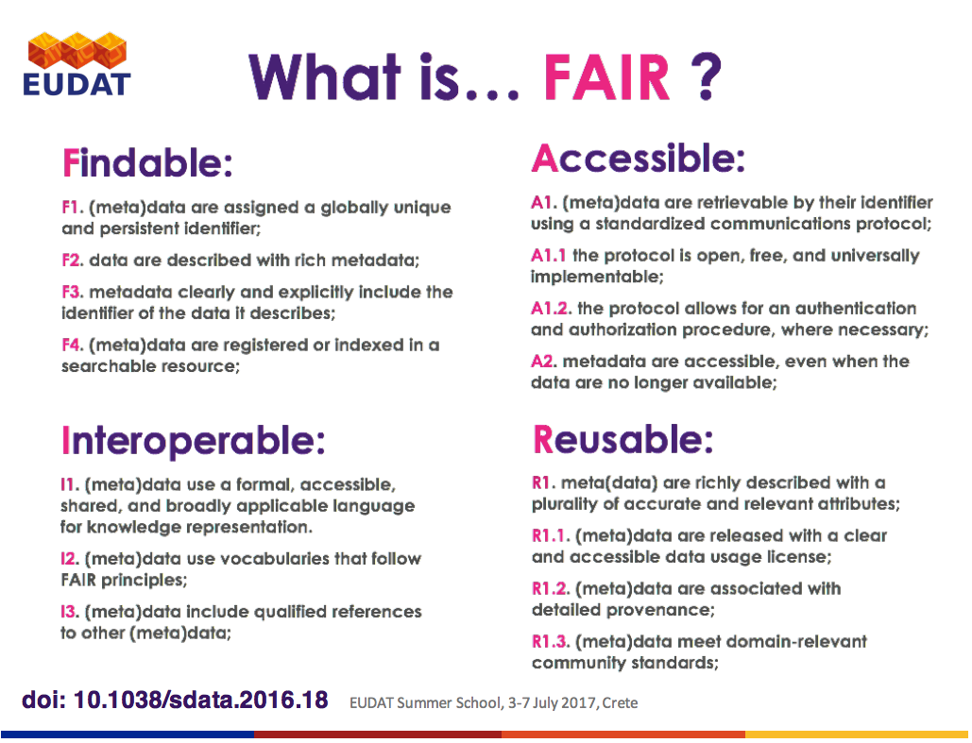
FAIR Data

Slide 9
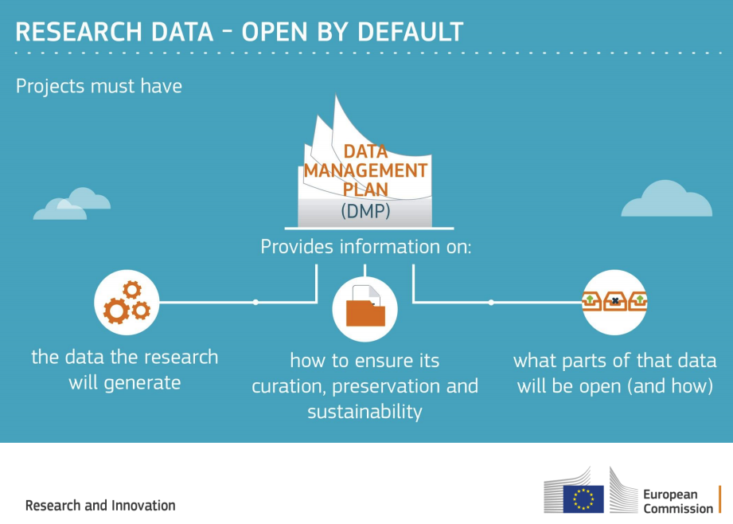
Data Management Plan
Data Management Plan (DMP): A document that outlines how data are to be handled both during and after a research project
research funders mandate writing a DMP
Type of data
Data & metadata standards
Data storage, sharing, & preserving
Budget & finance
...
Notes:
Today, an increasing number of funding agencies, journals, and other stakeholders are requiring data producers to share, archive, and plan for the management of their data. In order to respond to these requirements, researchers and information professionals will need the data management and curation knowledge and skills that support the long-term preservation, access, and reuse of data

Slide 10
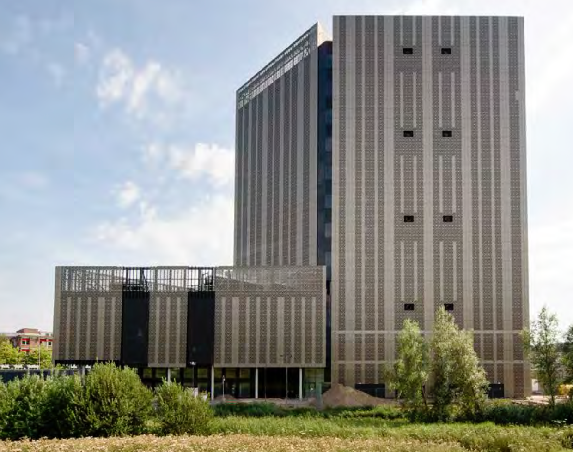
SURF’s Role in Research
Vision: Driving ICT innovation in education and research together
Focus of services:
High Performance Computing (Lisa, Cartesius, HPC Cloud)
Distributed computing (Grid)
Big Data
...
→ Larges infrastructure for (storing & processing ) large data

Slide 11




SURF Data Services
SURF object storage
Data Archive
Data ingest service

Slide 12
HPC and Data Management
Importance of HPC
Computationally intensive applications
Need to analyze more and more data
Reduce costs and increase efficiency
Challenges/Barriers to HPC
Data access/sharing
Complexity of use
I/O bottlenecks
Leads to poor overall application performance
Prevent applications from scaling
Notes:
Reduce costs and increase efficiency
Improve quality and be first to market
Make better and faster decisions
Applications becoming increasingly computationally intensive
Required to run more and more of these applications
Need to analyze more and more data

Slide 13
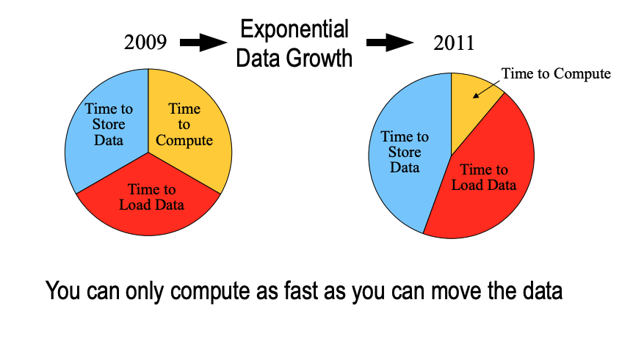
HPC and Data Access
Ref: High Performance Computing Data Management A European Perspective: http://web.stanford.edu/group/dlss/pasig/PASIG_October2009/Day1/PASIG_Oct09_PhT_V1.0.pdf

Slide 14
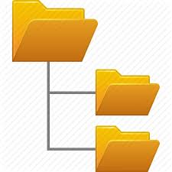

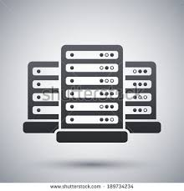
Archiving Data in HPC: Data Archive Service
Powerful transfer protocols:
- gridFTP, rsync, scp,…
Long-term storage of big data
Storage medium: Tape → high latency
Lisa/Cartesius
Tape
Copy data
Login
Archive
Easy access from HPC services Lisa and Cartesius via NFS mounts → use archive as yet another directory

Slide 15
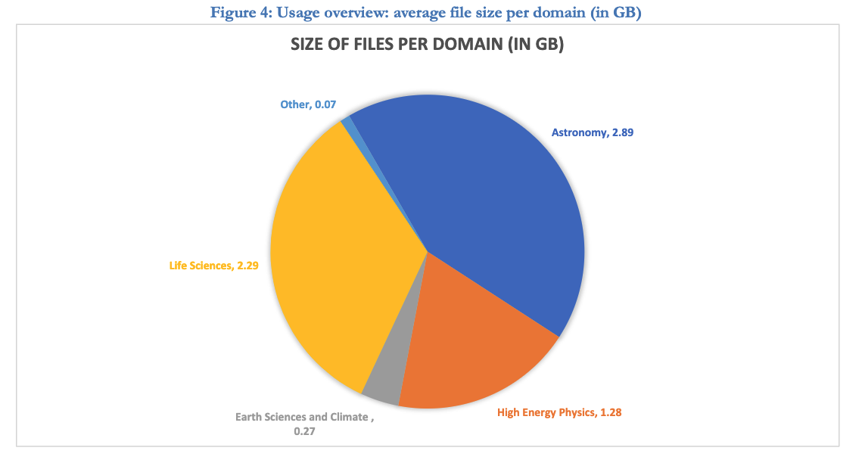
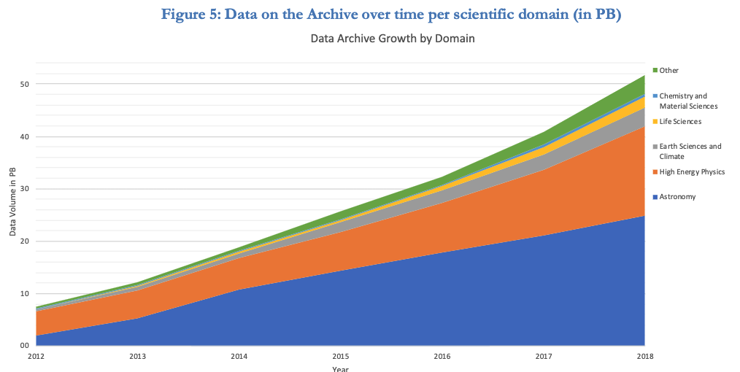
Data growth in the Data Archive: 10s of Petabyte of data

Slide 16
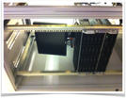
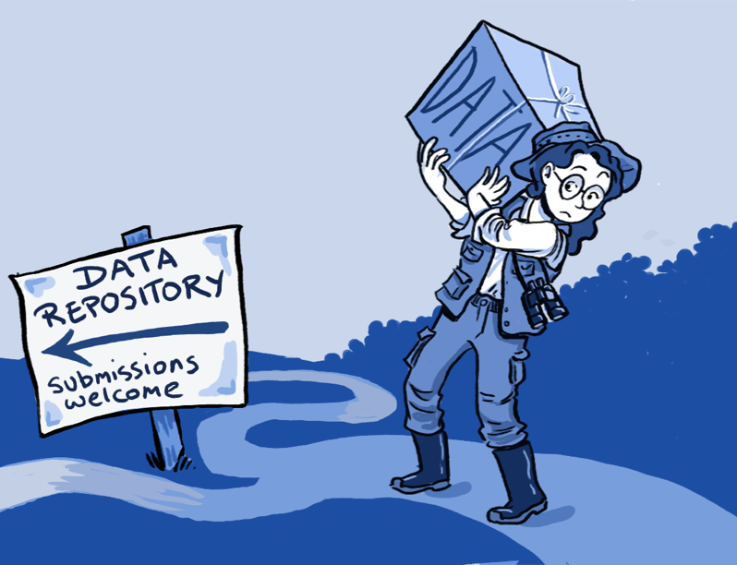

Data Ingest Service
Data often resides on external storage media, USB sticks, external hard drives
Slow or no internet connection
Easy way to upload large data from disk to SURFsara facilities
Upload data from 45 disks in parallel

Slide 17
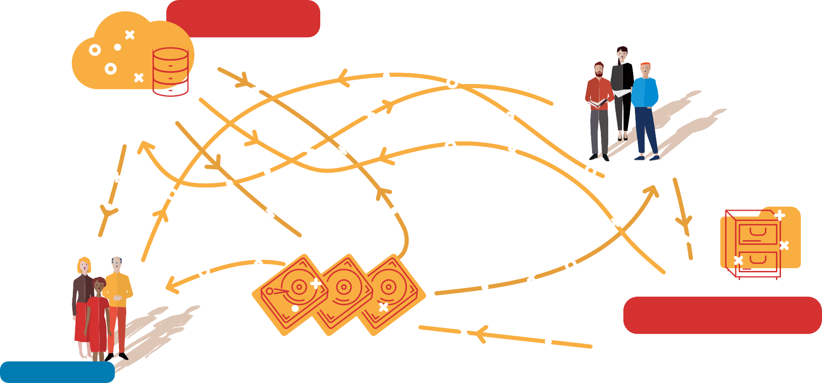
Difficulty in Sharing Data
CLOUD DATA
RESEARCH TEAM
ARCHIVE DRIVES
RESEARCH TEAM
LOCAL DRIVES

Slide 18

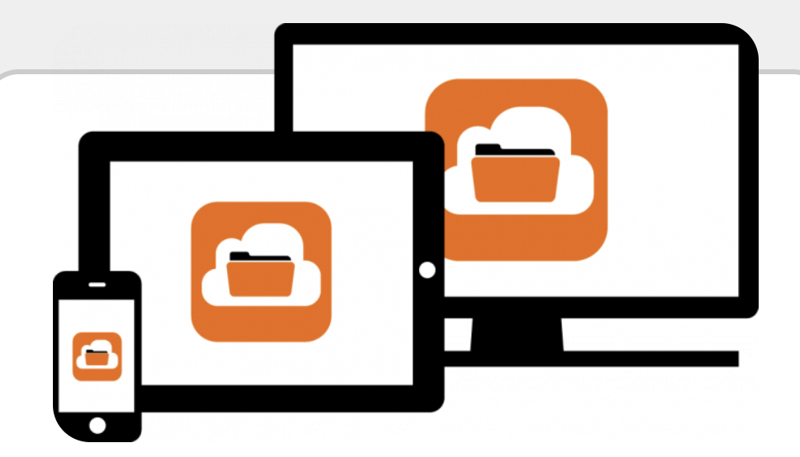
Data Sharing and personal storage: SURFdrive
Trusted community cloud for personal storage
Collaboration between SURFsara, SURFnet and Dutch universities
Specifications and service determined by end-users (universities)
Sharing smaller data files, documents,…
250 GB storage capacity per user
Privacy and security: Data in the Netherlands
Based on ownCloud,
Synchronizes with local storage,…
Access through: surfdrive.nl

Slide 19
Data Sharing and Team storage: ResearchDrive
COLLABORATIVE WORKING AND SHARING OF DATA FOR RESEARCH COLLABORATIONS
Trusted cloud storage for research teams
Facilitates collaborative research between teams
High quota’s (>250 GB) per user/group available
Sharing across similar cloud storage services
Based on ownCloud
Synchronization with local storages, Based on ownCloud
Data stewardship
Share
Research
Drive
Access Methods
OwnCloud sync clients
Cyberduck
Rclone sync client
Webdav API

Slide 20
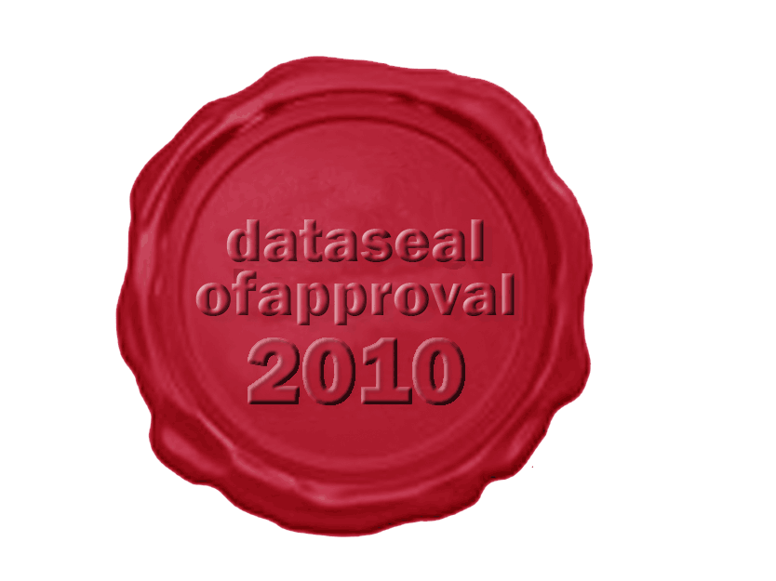
Publishing Research Data: SURF Data Repository
Data repository service to deposit and publish data
Long-term preservation of research data
Connected to tape and Data Archive in the backend
Provides quality to data sets via metadata descriptions
Makes data citable and findable via Persistent Identifiers
Status: Pre-production phase

Slide 21
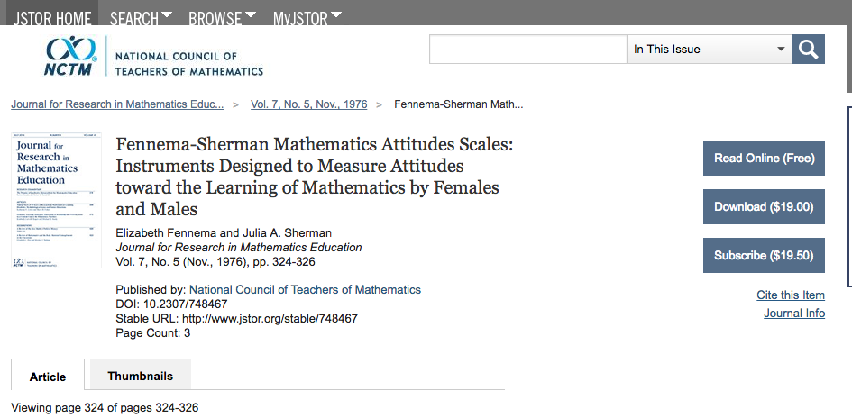
PID Service
PIDs (Persistent Identifiers) ensures the findability of your data
Pointers to resources like files, folders, webpages, real world objects
Globally unique and resolvable via http
Comparable to ISBN numbers assigned to books
Example resolvers: https://dx.doi.org/ and http://hdl.handle.net/
A PID consists of a prefix and a postfix (11304/2e873bd8-b988-11e3-8cd7-14feb57d12b9)
10.2307/748467

Slide 22
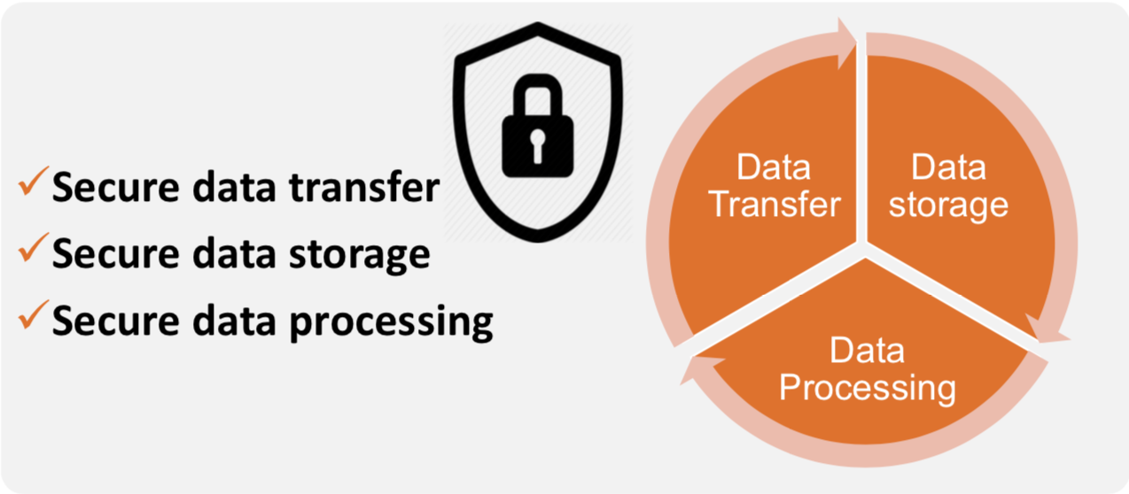
Sensitive Data and HPC
Sensitive data is data that must be protected against unwanted disclosure
Clinical Data, DNA sequences,…
Patient data, personal Data
Provide a secure environment on HPC for sensitive data
Comply with all legal and ethical requirements
GDPR, WGBO (Act on the Medical Treatment Agreement), CBS law

Slide 23
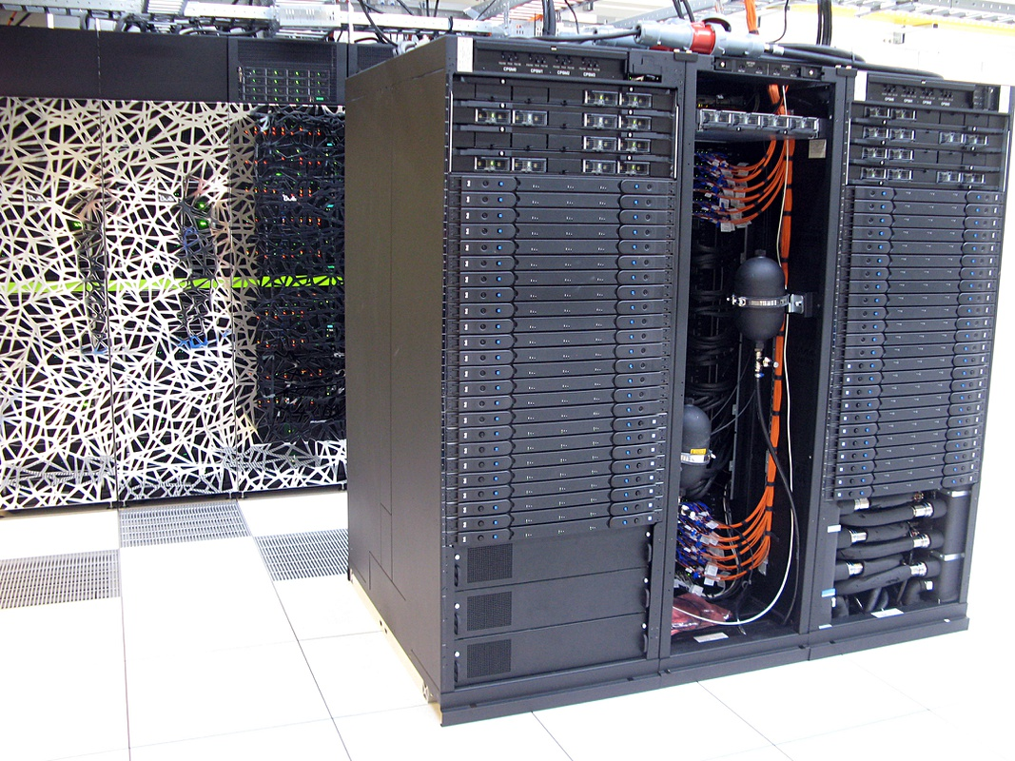
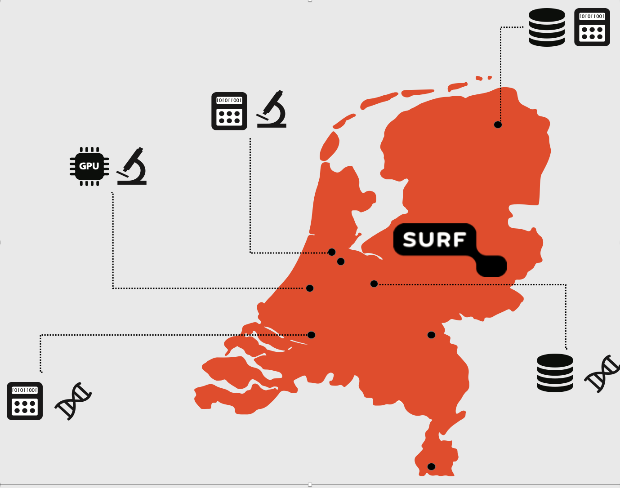
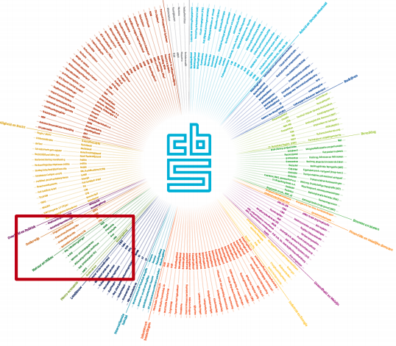
The ODISSEI Data Facility
A High-Performance Computer environment with secure access to sensitive data
Secure sandbox for processing data
Research Data
Micro data
Administrative data
CBS: Statistics Netherlands
Data Linking

Slide 24
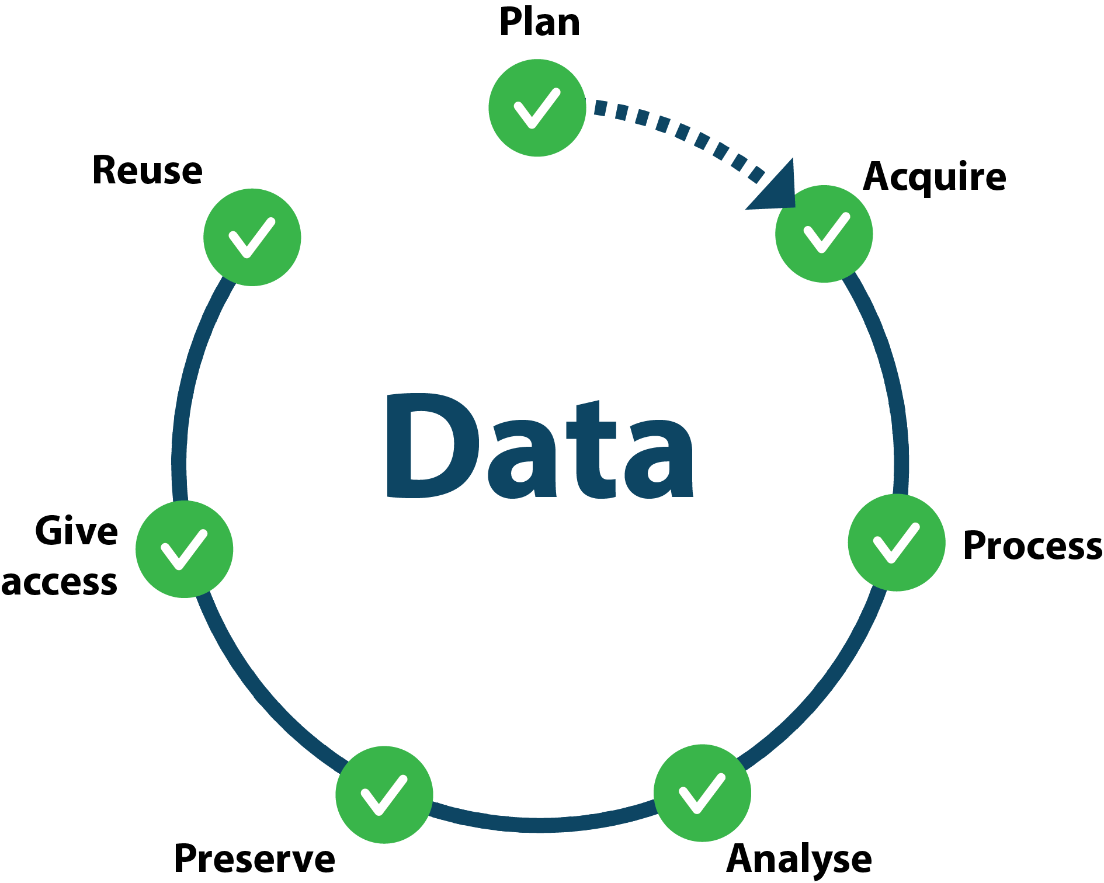


SURF Data Services
Data INGEST SERVICE
DATA REPOSITORY
PID SERVICE
Computing & Data processing services, e.g. HPC Cloud, LISA, Cartesius
DATA ARCHIVE
OBJECT STORAGE
For more detail, please see https://www.surf.nl/diensten-en-producten/categorie/datadiensten

Slide 25
Thank you!
Thanks to SURFsara’s …
… Data Preservation team
… Data Management team
… Online Data Services team

